Slide 1
ADO.NET PROJECT
BY
RANJAN .P
PRANATHI.K.S
INDIRA

Slide 2
DISCUSSION POINTS
CREATION OF TABLES
FORM 1 ( INSERTION OF EMPLOYEE TABLE )
FORM 2 ( INSERTION OF DEPARTMENT TABLE )
FORM 3 ( UPDATE )
FORM 4 ( DELETE )
FORM 5 ( SEARCH WRT EMPLOYEE SALARY )
FORM 6 ( SEARCH WRT EMPLOYEE NAME )
FORM 7 ( MANAGER DETAILS )

Slide 3
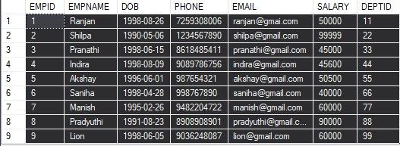
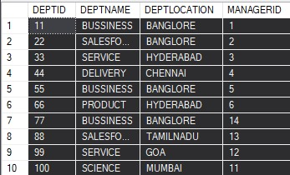
CREATION OF TABLES

Slide 4
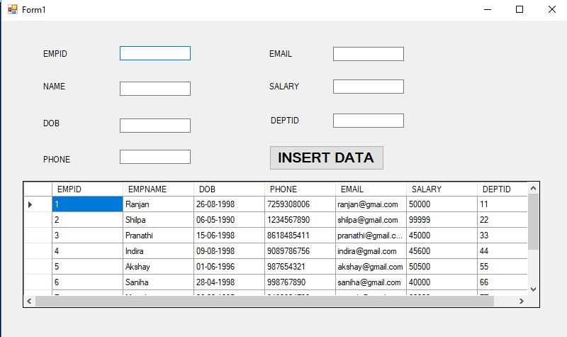
FORM 1 ( INSERTION OF EMP TABLE )
OUTPUT

Slide 5
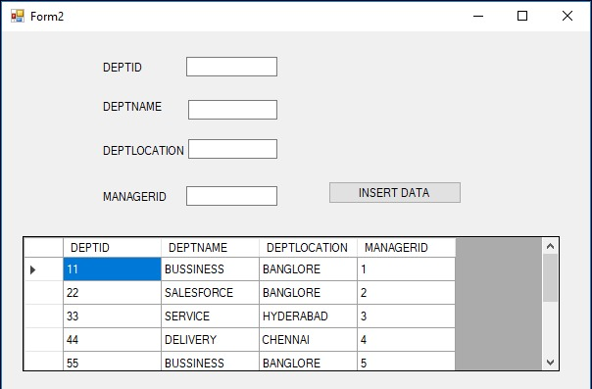
FORM 2 ( INSERTION OF DEPT TABLE )
OUTPUT

Slide 6
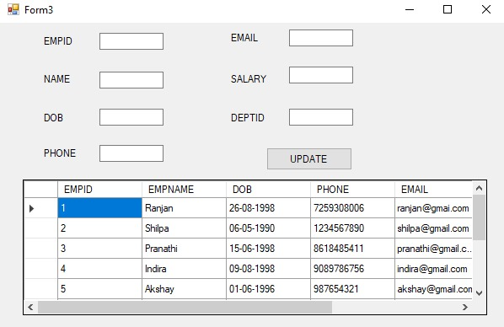
FORM 3 ( UPDATE )
OUTPUT

Slide 7
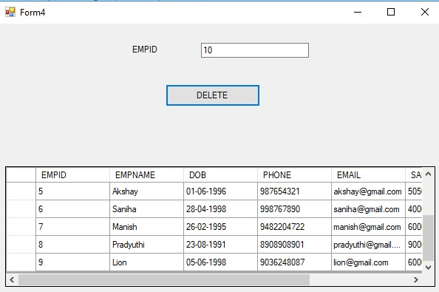
FORM 4 ( DELETE )
OUTPUT

Slide 8
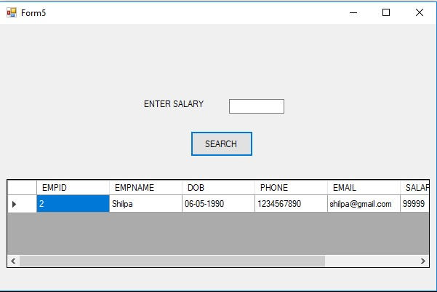
FORM 5 ( SEARCH WRT EMP SALARY )
OUTPUT

Slide 9
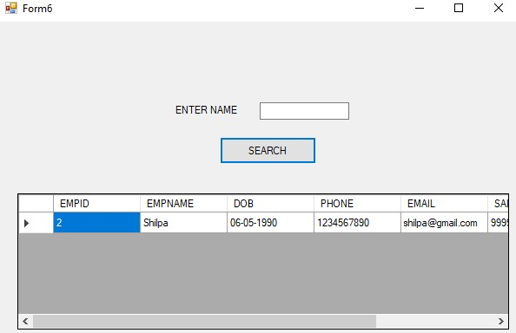
FORM 6 ( SEARCH WRT EMP NAME )
OUTPUT

Slide 10
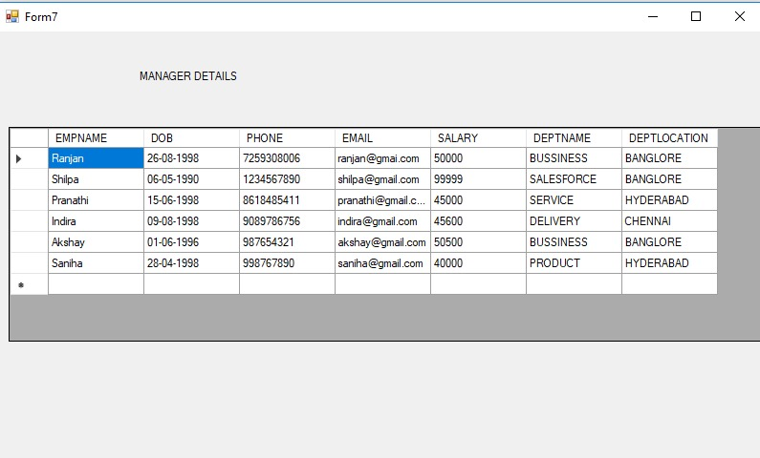
FORM 7 ( MANAGER DETAILS )
OUTPUT

Slide 11
THANK YOU

